Slide 1
Information Security Essential
ISC511
(LECTURE 1)
27-8-2025

Slide 2
How this course will be run
No ordinary student-Instructor based Teaching
You have to do most of the things by yourself
Reading
Presentations
Certification (Cisco)
And most importantly at the end of the course
!!!!! You will know what is security!!!!!

Slide 3

My Role
I am here to help you learn security
This course will be successful if at the end of course you know how to write a technical report and you have knowledge of security and you have some industrial certification.
Do Not worry!! I will show you how
I will teach you how to drive a car, but at the end of the day you have to steer. I am not going to drive the car for you.

Slide 4
Are you ready !!!!
Lets Begin

Slide 5
Information Security Essential
ISC511

Slide 6
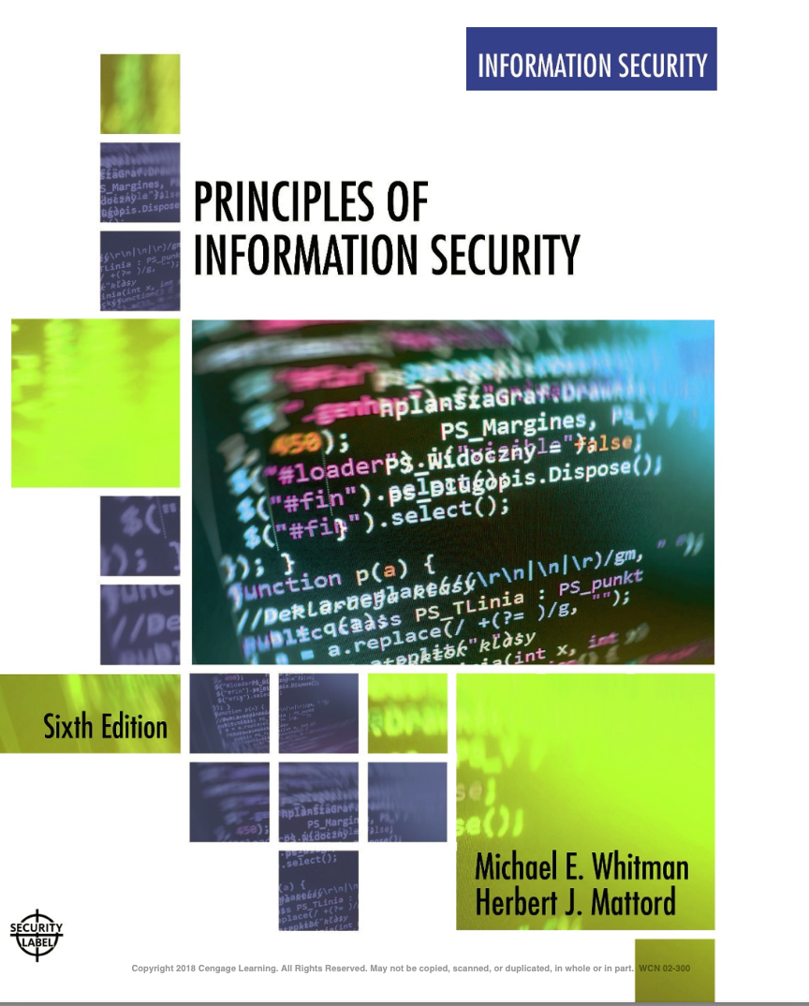
Course Textbook

Slide 7
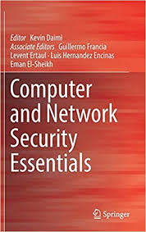
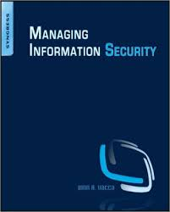
Reference Textbooks
Kevin Diami
John R Vacca

Slide 8
Course Breakdown
The course is roughly divided into 3 parts
  Security in General
  Network Security/Information
  Internet/Cyber Security

Slide 9
Organization of this Lecture
The Security Problem
Program Threats
System and Network Threats
Cryptography as a Security Tool
User Authentication
Implementing Security Defenses

Slide 10
Objectives
To discuss security threats and attacks
To explain the fundamentals of encryption, authentication, and hashing
To examine the uses of cryptography in computing
To describe the various countermeasures to security attacks

Slide 11
The Security Problem
System secure if resources used and accessed as intended under all circumstances
  Unachievable
Intruders (crackers) attempt to breach security
Threat is potential security violation
Attack is attempt to breach security
Attack can be accidental or malicious
Easier to protect against accidental than malicious misuse

Slide 12
Security Violation Categories
Breach of confidentiality
  Unauthorized reading of data
Breach of integrity
  Unauthorized modification of data
Breach of availability
  Unauthorized destruction of data
Theft of service
  Unauthorized use of resources
Denial of service (DOS)
  Prevention of legitimate use

Slide 13
Security Violation Methods
Masquerading (breach authentication)
  Pretending to be an authorized user to escalate privileges
Replay attack
  As is or with message modification
Man-in-the-middle attack
  Intruder sits in data flow, masquerading as sender to receiver and vice versa
Session hijacking
  Intercept an already-established session to bypass authentication

Slide 14
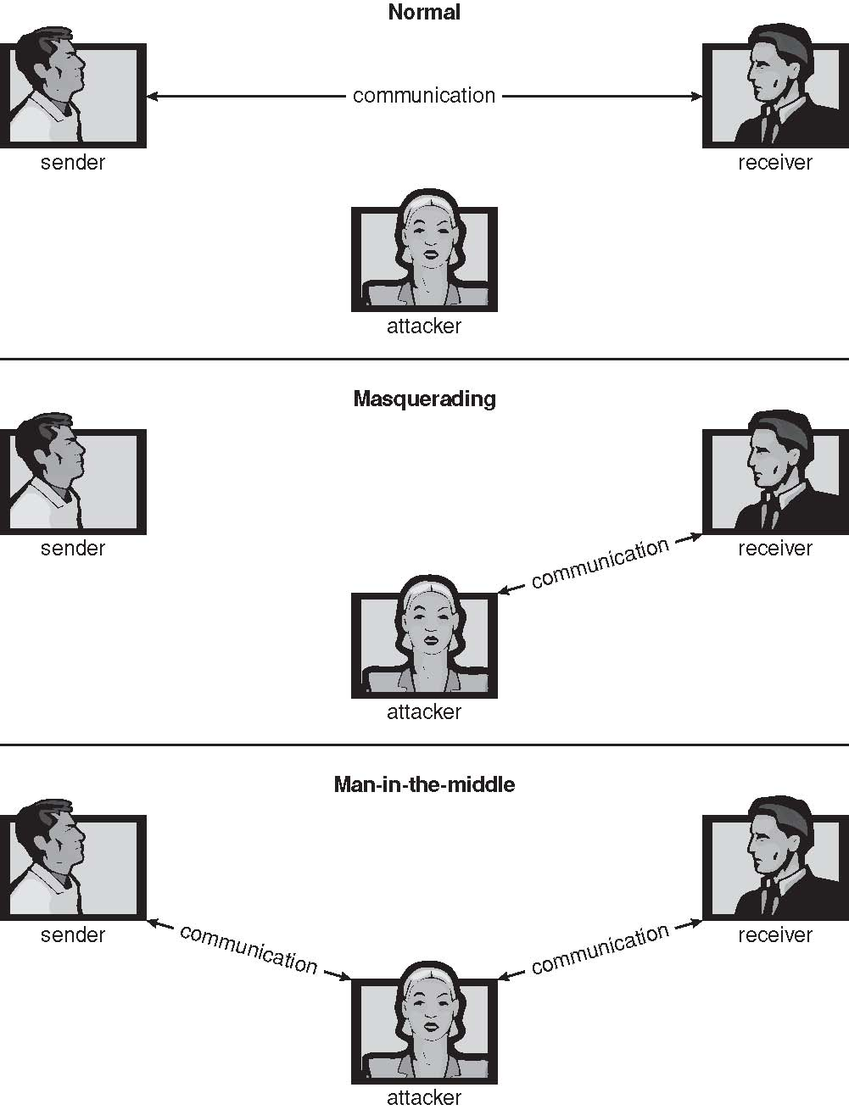
Standard Security Attacks

Slide 15
Security Measure Levels
Impossible to have absolute security, but make cost to perpetrator sufficiently high to deter most intruders
Security must occur at four levels to be effective:
  Physical
    Data centers, servers, connected terminals
  Human
    Avoid social engineering, phishing, dumpster diving
  Operating System
    Protection mechanisms, debugging
  Network
    Intercepted communications, interruption, DOS
Security is as weak as the weakest link in the chain
But can too much security be a problem?

Slide 16
Program Threats
Many variations, many names
Trojan Horse
  Code segment that misuses its environment
  Exploits mechanisms for allowing programs written by users to be executed by other users
  Spyware, pop-up browser windows, covert channels
  Up to 80% of spam delivered by spyware-infected systems
Trap Door
  Specific user identifier or password that circumvents normal security procedures
  Could be included in a compiler
  How to detect them?

Slide 17
Program Threats (Cont.)
Logic Bomb
  Program that initiates a security incident under certain circumstances
Stack and Buffer Overflow
  Exploits a bug in a program (overflow either the stack or memory buffers)
  Failure to check bounds on inputs, arguments
  Write pass arguments on the stack into the return address on stack
  When routine returns from call, returns to hacked address
    Pointed to code loaded onto stack that executes malicious code
  Unauthorized user or privilege escalation

Slide 18

Layout of Typical Stack Frame

Slide 19

Hypothetical Stack Frame
Before attack
After attack

Slide 20
Great Programming Required?
For the first step of determining the bug, and second step of writing exploit code, yes
Script kiddies can run pre-written exploit code to attack a given system
Attack code can get a shell with the processes’ owner’s permissions
  Or open a network port, delete files, download a program, etc.
Depending on bug, attack can be executed across a network using allowed connections, bypassing firewalls
Buffer overflow can be disabled by disabling stack execution or adding bit to page table to indicate “non-executable” state
  Available in SPARC and x86
  But still have security exploits

Slide 21
Program Threats (Cont.)
Viruses
  Code fragment embedded in legitimate program
  Self-replicating, designed to infect other computers
  Very specific to CPU architecture, operating system, applications
  Usually borne via email or as a macro
    Visual Basic Macro to reformat hard drive
      Sub AutoOpen()
      Dim oFS
      Set oFS = CreateObject(’’Scripting.FileSystemObject’’)
      vs = Shell(’’c:command.com /k format c:’’,vbHide)
      End Sub

Slide 22
Program Threats (Cont.)
Virus dropper inserts virus onto the system
Many categories of viruses, literally many thousands of viruses
  File / parasitic
  Boot / memory
  Macro
  Source code
  Polymorphic to avoid having a virus signature
  Encrypted
  Stealth
  Tunneling
  Multipartite
  Armored

Slide 23

A Boot-sector Computer Virus

Slide 24
The Threat Continues
Attacks still common, still occurring
Attacks moved over time from science experiments to tools of organized crime
  Targeting specific companies
  Creating botnets to use as tool for spam and DDOS delivery
  Keystroke logger to grab passwords, credit card numbers
Why is Windows the target for most attacks?
  Most common
  Everyone is an administrator
    Licensing required?
  Monoculture considered harmful

Slide 25
System and Network Threats
Some systems “open” rather than secure by default
  Reduce attack surface
  But harder to use, more knowledge needed to administer
Network threats harder to detect, prevent
  Protection systems weaker
  More difficult to have a shared secret on which to base access
  No physical limits once system attached to internet
    Or on network with system attached to internet
  Even determining location of connecting system difficult
    IP address is only knowledge

Slide 26
System and Network Threats (Cont.)
Worms – use spawn mechanism; standalone program
Internet worm
  Exploited UNIX networking features (remote access) and bugs in finger and sendmail programs
  Exploited trust-relationship mechanism used by rsh to access friendly systems without use of password
  Grappling hook program uploaded main worm program
    99 lines of C code
  Hooked system then uploaded main code, tried to attack connected systems
  Also tried to break into other users accounts on local system via password guessing

Slide 27

The Morris Internet Worm

Slide 28
System and Network Threats (Cont.)
Port scanning
  Automated attempt to connect to a range of ports on one or a range of IP addresses
  Detection of answering service protocol
  Detection of OS and version running on system
  nmap scans all ports in a given IP range for a response
  nessus has a database of protocols and bugs (and exploits) to apply against a system
  Frequently launched from zombie systems
    To decrease trace-ability

Slide 29
System and Network Threats (Cont.)
Denial of Service
  Overload the targeted computer preventing it from doing any useful work
  Distributed denial-of-service (DDOS) come from multiple sites at once
  Consider the start of the IP-connection handshake (SYN)
    How many started-connections can the OS handle?
  Consider traffic to a web site
    How can you tell the difference between being a target and being really popular?
  Accidental – CS students writing bad fork() code
  Purposeful – extortion, punishment

Slide 30
Sobig.F Worm
More modern example
Disguised as a photo uploaded to adult newsgroup via account created with stolen credit card
Targeted Windows systems
Had own SMTP engine to mail itself as attachment to everyone in infect system’s address book
Disguised with innocuous subject lines, looking like it came from someone known
Attachment was executable program that created WINPPR23.EXE in default Windows system directory
Plus the Windows Registry
[HKCU\SOFTWARE\Microsoft\Windows\CurrentVersion\Run]
"TrayX" = %windir%\winppr32.exe /sinc
[HKLM\SOFTWARE\Microsoft\Windows\CurrentVersion\Run]
"TrayX" = %windir%\winppr32.exe /sinc
  Resulted in CRASHED windows

Slide 31

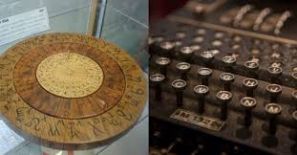
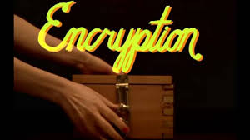

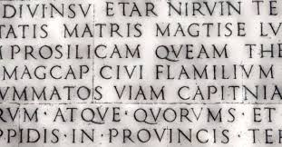
Security Tools
Cryptography

Slide 32
Cryptography as a Security Tool
Broadest security tool available
  Internal to a given computer, source and destination of messages can be known and protected
    OS creates, manages, protects process IDs, communication ports
  Source and destination of messages on network cannot be trusted without cryptography
    Local network – IP address?
      Consider unauthorized host added
    WAN / Internet – how to establish authenticity
      Not via IP address

Slide 33
Cryptography
Means to constrain potential senders (sources) and / or receivers (destinations) of messages
  Based on secrets (keys)
  Enables
    Confirmation of source
    Receipt only by certain destination
    Trust relationship between sender and receiver

Slide 34
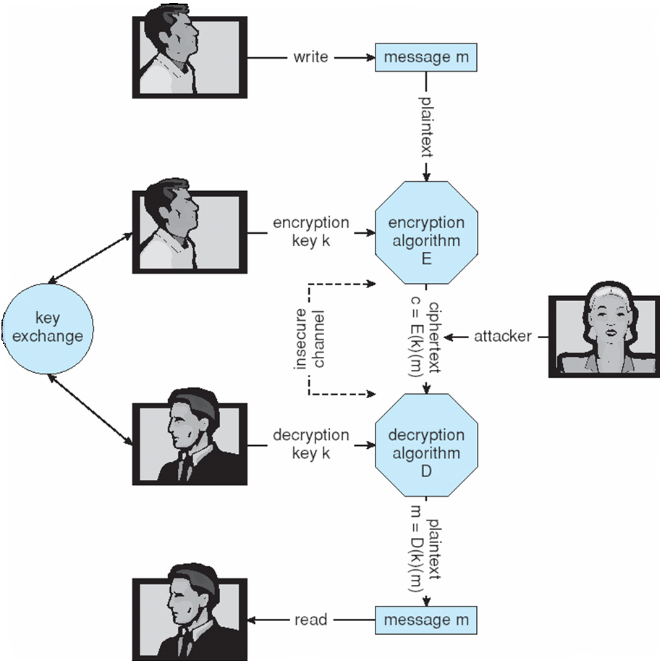
Secure Communication over
Insecure Medium

Slide 35
Encryption
Encryption algorithm consists of
  Set K of keys
  Set M of Messages
  Set C of ciphertexts (encrypted messages)
  A function E : K → (M→C). That is, for each k ∈ K, E(k) is a function for generating ciphertexts from messages

Slide 36
Symmetric Encryption
Same key used to encrypt and decrypt
  E(k) can be derived from ciphertext, and vice versa
DES is most commonly used symmetric block-encryption algorithm (created by US Govt)
  Encrypts a block of data at a time
Triple-DES considered more secure
Advanced Encryption Standard (AES),
RC4 is most common symmetric stream cipher,

Slide 37
Asymmetric Encryption
Public-key encryption based on each user having two keys:
  public key – published key used to encrypt data
  private key – key known only to individual user used to decrypt data
Must be an encryption scheme that can be made public without making it easy to figure out the decryption scheme

Slide 38
Authentication
Constraining set of potential senders of a message
  Complementary and sometimes redundant to encryption
  Also can prove message unmodified

Slide 39
Authentication – Digital Signature
Based on asymmetric keys and digital signature algorithm
Authenticators produced are digital signatures

Slide 40
Authentication (Cont.)
Why authentication if a subset of encryption?
  Fewer computations (except for RSA digital signatures)
  Authenticator usually shorter than message
  Sometimes want authentication but not confidentiality
    Signed patches et al
  Can be basis for non-repudiation

Slide 41


Implementation of Cryptography
Can be done at various levels of ISO Reference Model
  SSL at the Transport layer
  Network layer is typically IPSec
    IKE for key exchange
    Basis of VPNs
Why not just at lowest level?
  Sometimes need more knowledge than available at low levels
    i.e. User authentication
    i.e. e-mail delivery
Source: http://en.wikipedia.org/wiki/OSI_model

Slide 42
Implementing Security Defenses
Defense in depth is most common security theory – multiple layers of security
Security policy describes what is being secured
Vulnerability assessment compares real state of system / network compared to security policy
Intrusion detection endeavors to detect attempted or successful intrusions
  Signature-based detection spots known bad patterns
  Anomaly detection spots differences from normal behavior
    Can detect zero-day attacks
  False-positives and false-negatives a problem
Virus protection
Auditing, accounting, and logging of all or specific system or network activities

Slide 43
Firewalling to Protect Systems and Networks
A network firewall is placed between trusted and untrusted hosts
  The firewall limits network access between these two security domains
Can be tunneled or spoofed
  Tunneling allows disallowed protocol to travel within allowed protocol (i.e., telnet inside of HTTP)
  Firewall rules typically based on host name or IP address which can be spoofed
Personal firewall is software layer on given host
  Can monitor / limit traffic to and from the host
Application proxy firewall understands application protocol and can control them (i.e., SMTP)
System-call firewall monitors all important system calls and apply rules to them (i.e., this program can execute that system call)

Slide 44
Computer Security Classifications
U.S. Department of Defense outlines four divisions of computer security: A, B, C, and D
D – Minimal security
C – Provides discretionary protection through auditing
  Divided into C1 and C2
    C1 identifies cooperating users with the same level of protection
    C2 allows user-level access control
B – All the properties of C, however each object may have unique sensitivity labels
  Divided into B1, B2, and B3
A – Uses formal design and verification techniques to ensure security

Slide 45
Example: Windows
Security is based on user accounts
  Each user has unique security ID
  Login to ID creates security access token
    Includes security ID for user, for user’s groups, and special privileges
    Every process gets copy of token
    System checks token to determine if access allowed or denied
Uses a subject model to ensure access security
  A subject tracks and manages permissions for each program that a user runs
Each object in Windows has a security attribute defined by a security descriptor
  For example, a file has a security descriptor that indicates the access permissions for all users

Slide 46
The End

